Slide 1

Ví dụ về cách hoạt động của Decoder
Mai Minh Quân - 20225661

Slide 2
Tổng quan luồng xử lý của Decoder
Phân tích cụ thể qua ví dụ dịch “Xin chào” → “Hello”.
Thực hiện qua 3 khối chính:
Masked Multi-Head Self-Attention
Multi-Head Cross-Attention
Feed-Forward Network
Sau mỗi khối có: Add & Norm.

Slide 3
Ví dụ về cách hoạt động của Decoder
Các bước trong hoạt động của Encoder
Bước 1 - Input Embedding
Bước 2 - Positional Encoding
Bước 3 - Masked Multi-Head Self-Attention
Bước 4 - Add & Norm Sau Masked Multi-Head Self-Attention
Bước 5 - Multi-Head Cross-Attention
Bước 6 - Add & Norm Sau Multi-Head Cross-Attention
Bước 7 - Feed-Forward Network
Bước 8 - Add & Norm Sau Feed-Forward Network
Bước 9 - Final Linear & Softmax

Slide 4
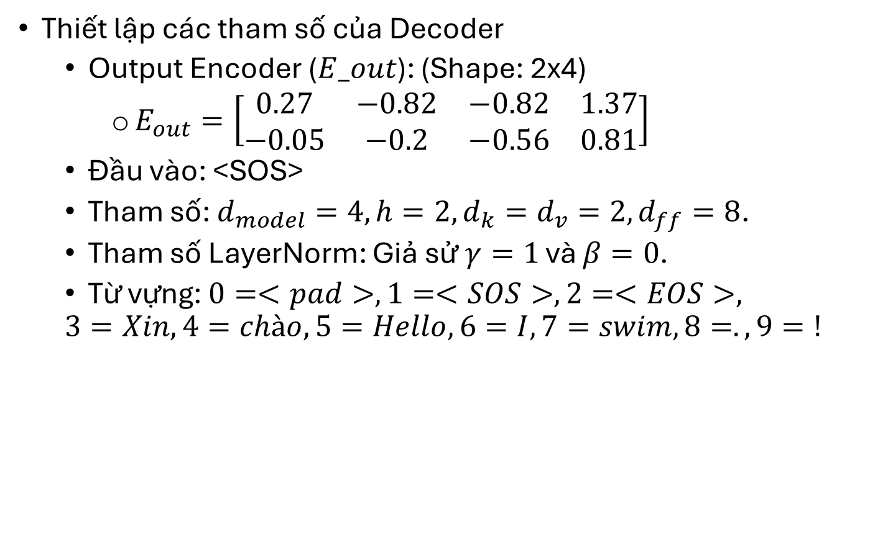
Thiết lập tham số
Thiết lập các tham số của Decoder
Output Encoder ($E_out$​): (Shape: 2x4)
$E_{out}=\left[\begin{matrix}0.27 & −0.82 & −0.82 & 1.37 \\ −0.05 & −0.2 & −0.56 & 0.81\end{matrix}\right]$
Đầu vào: <SOS>
Tham số: $d_{model}​=4, h=2, d_{k}​=d_{v}​=2, d_{ff}​=8$.
Tham số LayerNorm: Giả sử $γ=1$ và $β=0$.
Từ vựng: $0=<pad>, 1=<SOS>, 2=<EOS>,$
$$3=Xin, 4=chào, 5=Hello, 6=I, 7=swim, 8=., 9=!$$

Slide 5

Tạo Token thứ nhất ("Hello")
B1: Target Input Embedding: $X_{target}$ = $\left[\begin{matrix}0.5 & 0.5 & 0.5 & 0.5\end{matrix} \right]$
B2: Target Positional Encoding (PE):
$PE_{0}=\left[\begin{matrix}0 & 1 & 0 & 1\end{matrix}\right]$
$X_{target_emb}=\left[\begin{matrix}0.5 & 1.5 & 0.5 & 1.5\end{matrix}\right]$

Slide 6
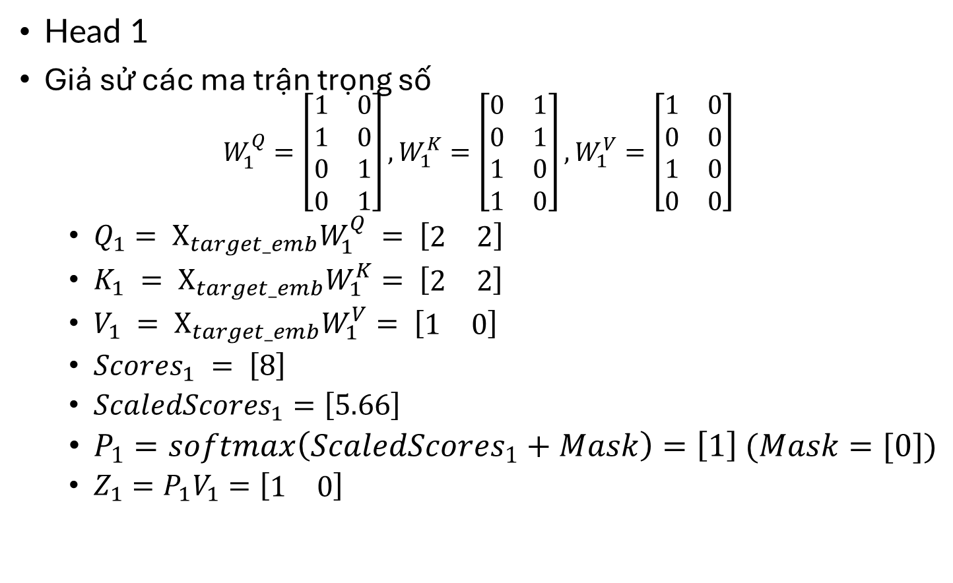
B3: Masked Multi-Head Self-Attention
Head 1
Giả sử các ma trận trọng số
$$W_{1}^{Q}=\left[\begin{matrix}1 & 0 \\ 1 & 0 \\ 0 & 1 \\ 0 & 1\end{matrix}\right],W_{1}^{K}=\left[\begin{matrix}0 & 1 \\ 0 & 1 \\ 1 & 0 \\ 1 & 0\end{matrix}\right],W_{1}^{V}=\left[\begin{matrix}1 & 0 \\ 0 & 0 \\ 1 & 0 \\ 0 & 0\end{matrix}\right]$$
$Q_{1}= X_{target_emb}W_{1}^{Q} = \left[\begin{matrix}2 & 2\end{matrix}\right]$
$K_{1} = X_{target_emb}W_{1}^{K}= \left[\begin{matrix}2 & 2\end{matrix}\right]$
$V_{1} = X_{target_emb}W_{1}^{V}= \left[\begin{matrix}1 & 0\end{matrix}\right]$
$Scores_{1} = \left[8\right]$
$ScaledScores_{1}=\left[5.66\right]$
$P_{1}=softmax\left(ScaledScores_{1}+Mask\right)=\left[1\right] (Mask=[0])$
$Z_{1}=P_{1}V_{1}=\left[\begin{matrix}1 & 0\end{matrix}\right]$

Slide 7
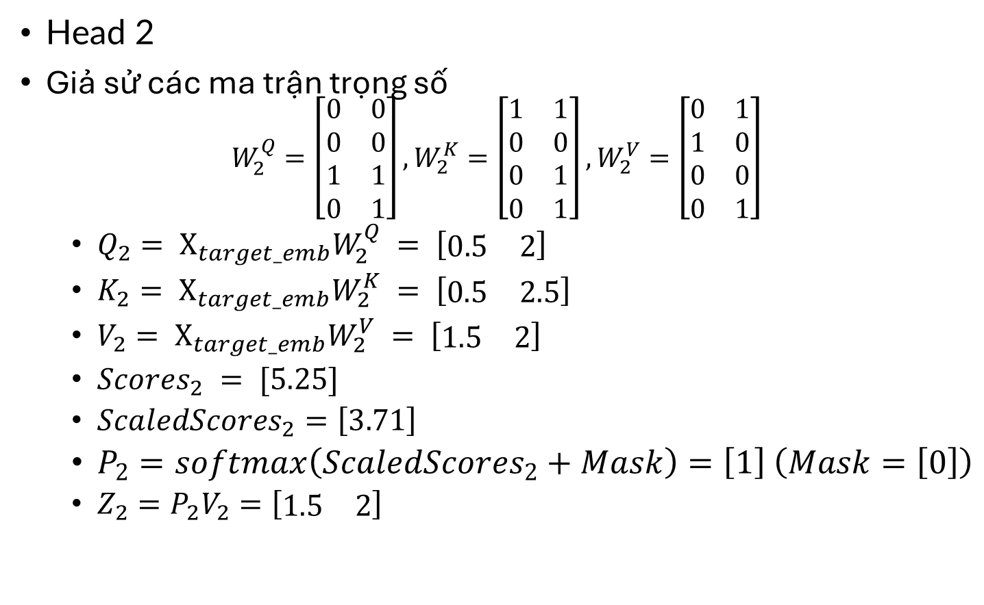
B3: Masked Multi-Head Self-Attention
Head 2
Giả sử các ma trận trọng số
$$W_{2}^{Q}=\left[\begin{matrix}0 & 0 \\ 0 & 0 \\ 1 & 1 \\ 0 & 1\end{matrix}\right],W_{2}^{K}=\left[\begin{matrix}1 & 1 \\ 0 & 0 \\ 0 & 1 \\ 0 & 1\end{matrix}\right],W_{2}^{V}=\left[\begin{matrix}0 & 1 \\ 1 & 0 \\ 0 & 0 \\ 0 & 1\end{matrix}\right]$$
$Q_{2}= X_{target_emb}W_{2}^{Q} = \left[\begin{matrix}0.5 & 2\end{matrix}\right]$
$K_{2}= X_{target_emb}W_{2}^{K} = \left[\begin{matrix}0.5 & 2.5\end{matrix}\right]$
$V_{2}= X_{target_emb}W_{2}^{V} = \left[\begin{matrix}1.5 & 2\end{matrix}\right]$
$Scores_{2} = [5.25]$
$ScaledScores_{2}=\left[3.71\right]$
$P_{2}=softmax\left(ScaledScores_{2}+Mask\right)=\left[1\right] \left(Mask=\left[0\right]\right)$
$Z_{2}=P_{2}V_{2}=\left[\begin{matrix}1.5 & 2\end{matrix}\right]$

Slide 8

B3: Masked Multi-Head Self-Attention
Concatenate & Final Linear
$Z_{concat}=\left[\begin{matrix}1 & 0 & 1.5 & 2\end{matrix}\right]$
$Z_{MHA} = \left[\begin{matrix}1 & 0 & 1.5 & 2\end{matrix}\right]$

Slide 9

B4: Add & Norm Sau Masked Multi-Head Self-Attention
$X_{add1_dec} =\left[\begin{matrix}0.5 & 1.5 & 0.5 & 1.5\end{matrix}\right] +\left[\begin{matrix}1 & 0 & 1.5 & 2\end{matrix}\right] = \left[\begin{matrix}1.5 & 1.5 & 2 & 3.5\end{matrix}\right]$
$X_{norm1_dec}=$ $\left[\begin{matrix}−0.76 & −0.76 & −0.15 & 1.67\end{matrix}\right]$

Slide 10
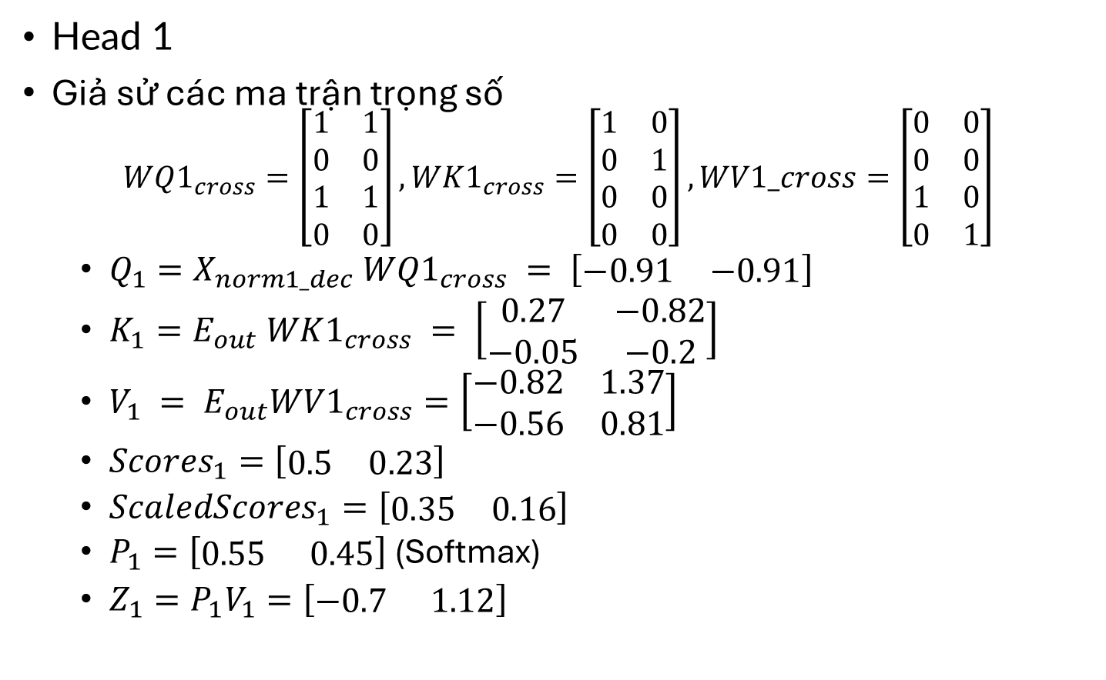
B5: Multi-Head Cross-Attention
Head 1
Giả sử các ma trận trọng số
$$WQ1_{cross}=\left[\begin{matrix}1 & 1 \\ 0 & 0 \\ 1 & 1 \\ 0 & 0\end{matrix}\right],WK1_{cross}=\left[\begin{matrix}1 & 0 \\ 0 & 1 \\ 0 & 0 \\ 0 & 0\end{matrix}\right],WV1_cross=\left[\begin{matrix}0 & 0 \\ 0 & 0 \\ 1 & 0 \\ 0 & 1\end{matrix}\right]$$
$Q_{1}=X_{norm1_dec} WQ1_{cross} = \left[\begin{matrix}−0.91 & −0.91\end{matrix}\right]$
$K_{1}=E_{out} WK1_{cross} = \left[\begin{matrix}0.27 & −0.82 \\ −0.05 & −0.2\end{matrix}\right]$
$V_{1} = E_{out}WV1_{cross}=\left[\begin{matrix}−0.82 & 1.37 \\ −0.56 & 0.81\end{matrix}\right]$
$Scores_{1}=$ $\left[\begin{matrix}0.5 & 0.23\end{matrix}\right]$
$ScaledScores_{1}=$ $\left[\begin{matrix}0.35 & 0.16\end{matrix}\right]$
$P_{1}=\left[\begin{matrix}0.55 & 0.45\end{matrix}\right]$ (Softmax)
$Z_{1}=P_{1}V_{1}=$ $\left[\begin{matrix}−0.7 & 1.12\end{matrix}\right]$

Slide 11
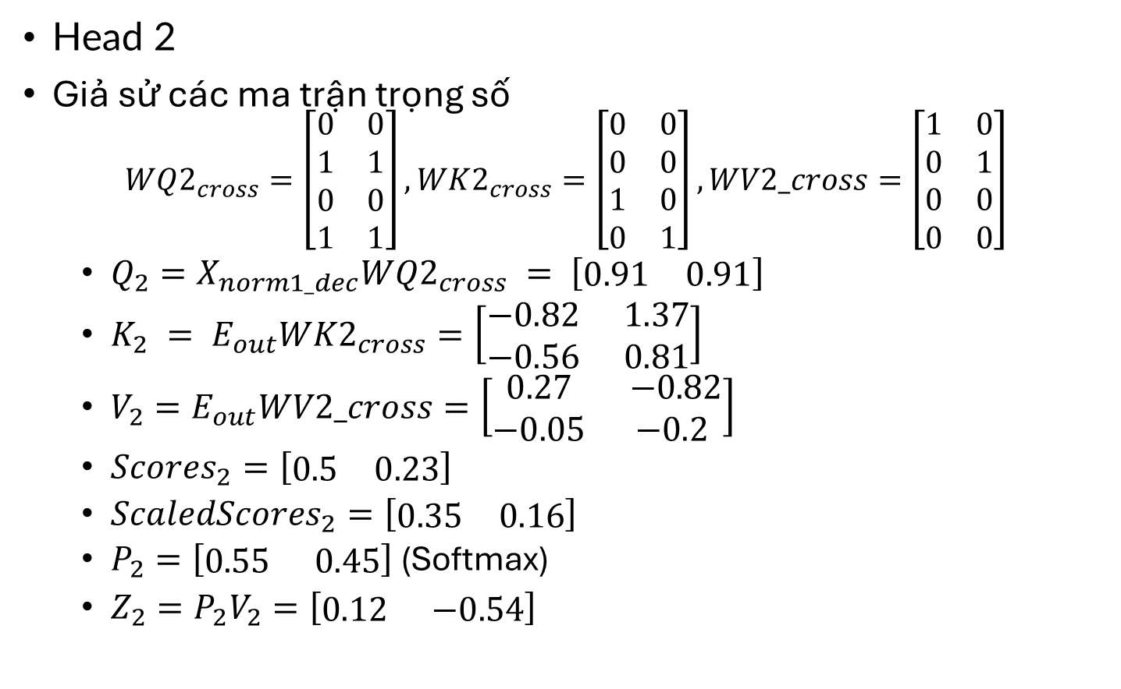
B5: Multi-Head Cross-Attention
Head 2
Giả sử các ma trận trọng số
$$WQ2_{cross}=\left[\begin{matrix}0 & 0 \\ 1 & 1 \\ 0 & 0 \\ 1 & 1\end{matrix}\right],WK2_{cross}=\left[\begin{matrix}0 & 0 \\ 0 & 0 \\ 1 & 0 \\ 0 & 1\end{matrix}\right],WV2_cross=\left[\begin{matrix}1 & 0 \\ 0 & 1 \\ 0 & 0 \\ 0 & 0\end{matrix}\right]$$
$Q_{2}=X_{norm1_dec}WQ2_{cross} = \left[\begin{matrix}0.91 & 0.91\end{matrix}\right]$
$K_{2} = E_{out}WK2_{cross}=\left[\begin{matrix}−0.82 & 1.37 \\ −0.56 & 0.81\end{matrix}\right]$
$V_{2}=E_{out}WV2_cross=\left[\begin{matrix}0.27 & −0.82 \\ −0.05 & −0.2\end{matrix}\right]$
$Scores_{2}=\left[\begin{matrix}0.5 & 0.23\end{matrix}\right]$
$ScaledScores_{2}=\left[\begin{matrix}0.35 & 0.16\end{matrix}\right]$
$P_{2}=\left[\begin{matrix}0.55 & 0.45\end{matrix}\right]$ (Softmax)
$Z_{2}=P_{2}V_{2}=\left[\begin{matrix}0.12 & −0.54\end{matrix}\right]$

Slide 12

B5: Multi-Head Cross-Attention
Concatenate & Final Linear:
$Z_{concat}=\left[\begin{matrix}−0.7 & 1.12 & 0.12 & −0.54\end{matrix}\right]$
$Z_{MHA_cross}=$ $\left[\begin{matrix}−0.7 & 1.12 & 0.12 & −0.54\end{matrix}\right]$

Slide 13

B6: Add & Norm Sau Multi-Head Cross-Attention
$X_{add_dec}=\left[\begin{matrix}−0.76 & −0.76 & −0.15 & 1.67\end{matrix}\right]+\left[\begin{matrix}−0.7 & 1.12 & 0.12 & −0.54\end{matrix}\right]=$ $\left[\begin{matrix}−1.46 & 0.36 & −0.03 & 1.13\end{matrix}\right]$
$X_{norm2_dec}$ $=\left[\begin{matrix}−1.55 & 0.38 & −0.03 & 1.2\end{matrix}\right]$

Slide 14
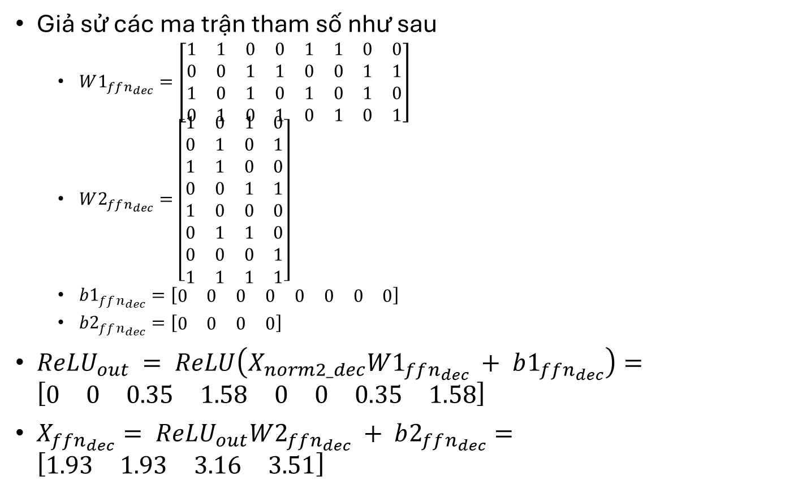
B7: Feed-Forward Network (FFN)
Giả sử các ma trận tham số như sau
$W1_{ffn_{dec}}=\left[\begin{matrix}1 & 1 & 0 & 0 & 1 & 1 & 0 & 0 \\ 0 & 0 & 1 & 1 & 0 & 0 & 1 & 1 \\ 1 & 0 & 1 & 0 & 1 & 0 & 1 & 0 \\ 0 & 1 & 0 & 1 & 0 & 1 & 0 & 1\end{matrix}\right]$
$W2_{ffn_{dec}}=\left[\begin{matrix}1 & 0 & 1 & 0 \\ 0 & 1 & 0 & 1 \\ 1 & 1 & 0 & 0 \\ 0 & 0 & 1 & 1 \\ 1 & 0 & 0 & 0 \\ 0 & 1 & 1 & 0 \\ 0 & 0 & 0 & 1 \\ 1 & 1 & 1 & 1\end{matrix}\right]$
$b1_{ffn_{dec}}=\left[\begin{matrix}0 & 0 & 0 & 0 & 0 & 0 & 0 & 0\end{matrix}\right]$
$b2_{ffn_{dec}}=\left[\begin{matrix}0 & 0 & 0 & 0\end{matrix}\right]$
$ReLU_{out} = ReLU\left(X_{norm2_dec}W1_{ffn_{dec}} + b1_{ffn_{dec}}\right)=$ $\left[\begin{matrix}0 & 0 & 0.35 & 1.58 & 0 & 0 & 0.35 & 1.58\end{matrix}\right]$
$X_{ffn_{dec}}= ReLU_{out}W2_{ffn_{dec}} + b2_{ffn_{dec}}=$ $\left[\begin{matrix}1.93 & 1.93 & 3.16 & 3.51\end{matrix}\right]$

Slide 15

Bước 8 - Add & Norm Sau Feed-Forward Network
$X_{add3_dec}=\left[\begin{matrix}−1.55 & 0.38 & −0.03 & 1.2\end{matrix}\right]+\left[\begin{matrix}1.93 & 1.93 & 3.16 & 3.51\end{matrix}\right]=\left[\begin{matrix}0.38 & 2.31 & 3.13 & 4.71\end{matrix}\right]$
$X_{decoder_layer_out}=\left[\begin{matrix}−1.44 & −0.21 & 0.32 & 1.33\end{matrix}\right]$

Slide 16
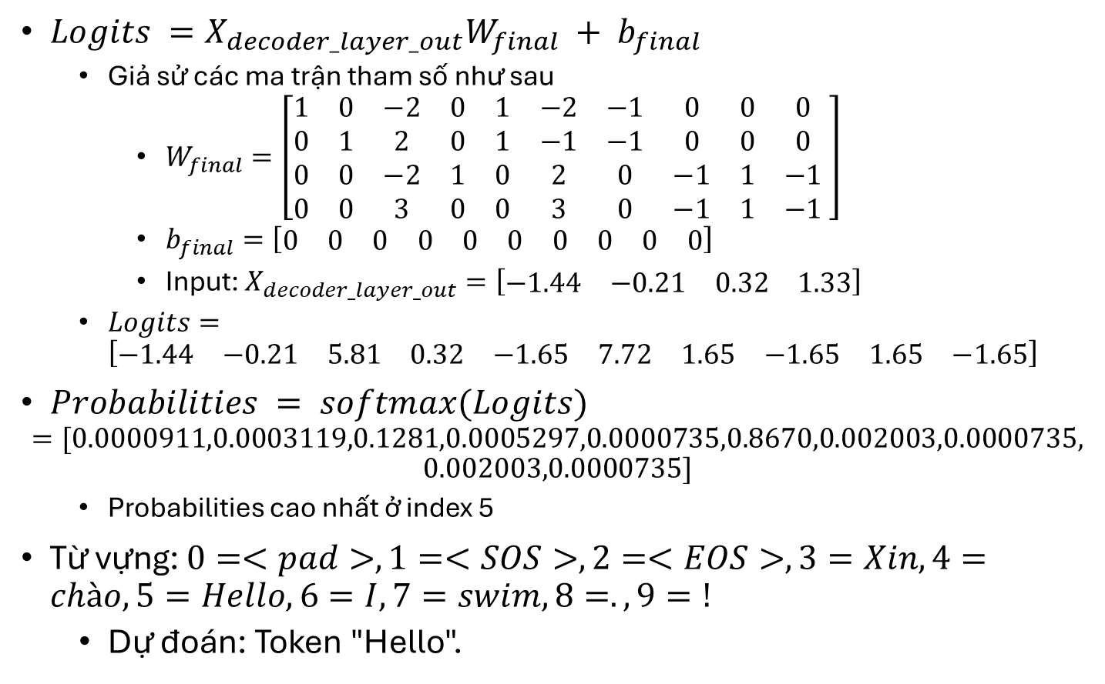
B9: Final Linear & Softmax
$Logits =X_{decoder_layer_out}W_{final} + b_{final}$
Giả sử các ma trận tham số như sau
$W_{final}=\left[\begin{matrix}1 & 0 & −2 & 0 & 1 & −2 & −1 & 0 & 0 & 0 \\ 0 & 1 & 2 & 0 & 1 & −1 & −1 & 0 & 0 & 0 \\ 0 & 0 & −2 & 1 & 0 & 2 & 0 & −1 & 1 & −1 \\ 0 & 0 & 3 & 0 & 0 & 3 & 0 & −1 & 1 & −1\end{matrix} \right]$
$b_{final}=\left[\begin{matrix}0 & 0 & 0 & 0 & 0 & 0 & 0 & 0 & 0 & 0\end{matrix}\right]$
Input: $X_{decoder_layer_out}=\left[\begin{matrix}−1.44 & −0.21 & 0.32 & 1.33\end{matrix}\right]$
$Logits=\left[\begin{matrix}−1.44 & −0.21 & 5.81 & 0.32 & −1.65 & 7.72 & 1.65 & −1.65 & 1.65 & −1.65\end{matrix}\right]$
$Probabilities = softmax(Logits)$
$$=[0.0000911,0.0003119,0.1281,0.0005297,0.0000735,0.8670,0.002003,0.0000735,$$
$$0.002003,0.0000735]$$
Probabilities cao nhất ở index 5
Từ vựng: $0=<pad>, 1=<SOS>, 2=<EOS>, 3=Xin, 4=chào, 5=Hello, 6=I, 7=swim, 8=., 9=!$
Dự đoán: Token "Hello".

Slide 17
THANK YOU !

